Slide 1
The Data Analysis and Visualization of the Most Recent Updated Videos on Bilibili
STAS401 Tableau Project Presentation
Boqing Zheng, Shuhe Wang, Xingyu Shen
Data Science
Duke Kunshan University
Feb 4, 2022

Slide 2

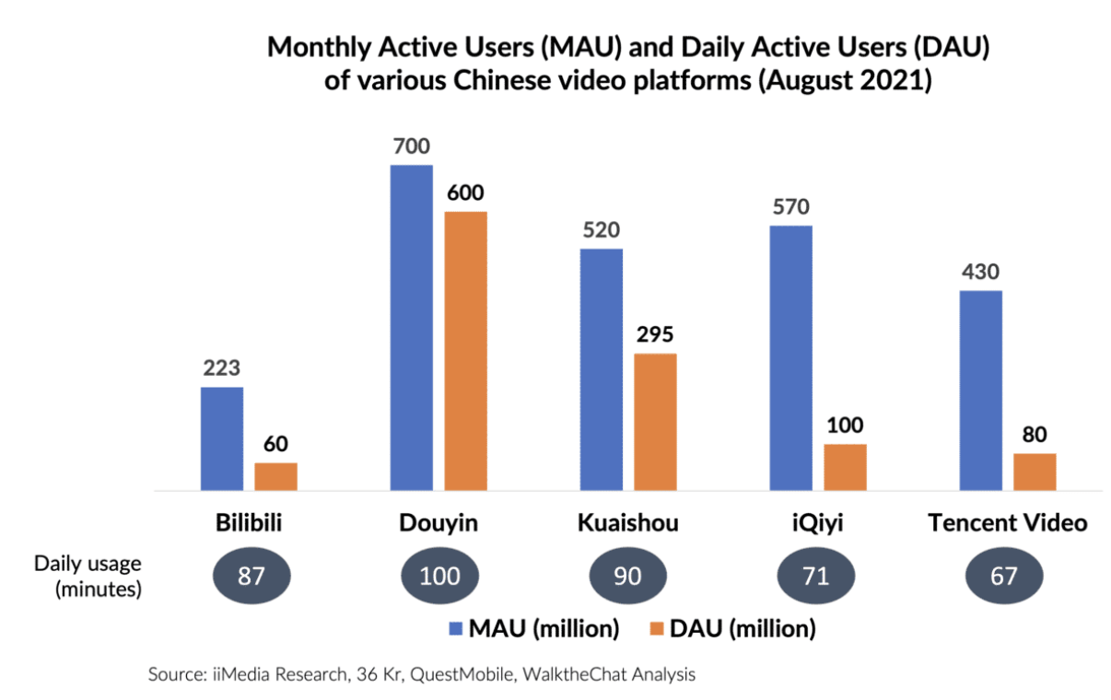
Introduction
Bilibili is an iconic brand and a leading video community for young generations in China.
“All the Videos You Like”
Golden opportunity from videolization
Unparalleled Leadership among Generation Z+
Highly sticky community with a strong sense of belonging

Slide 3
Introduction
Research Questions:
What is the relationship between feedbacks of the audience and the number of views?
What are the common characteristics of the videos published recently?
What are the popular topics and keywords of the videos among young people?

Slide 4
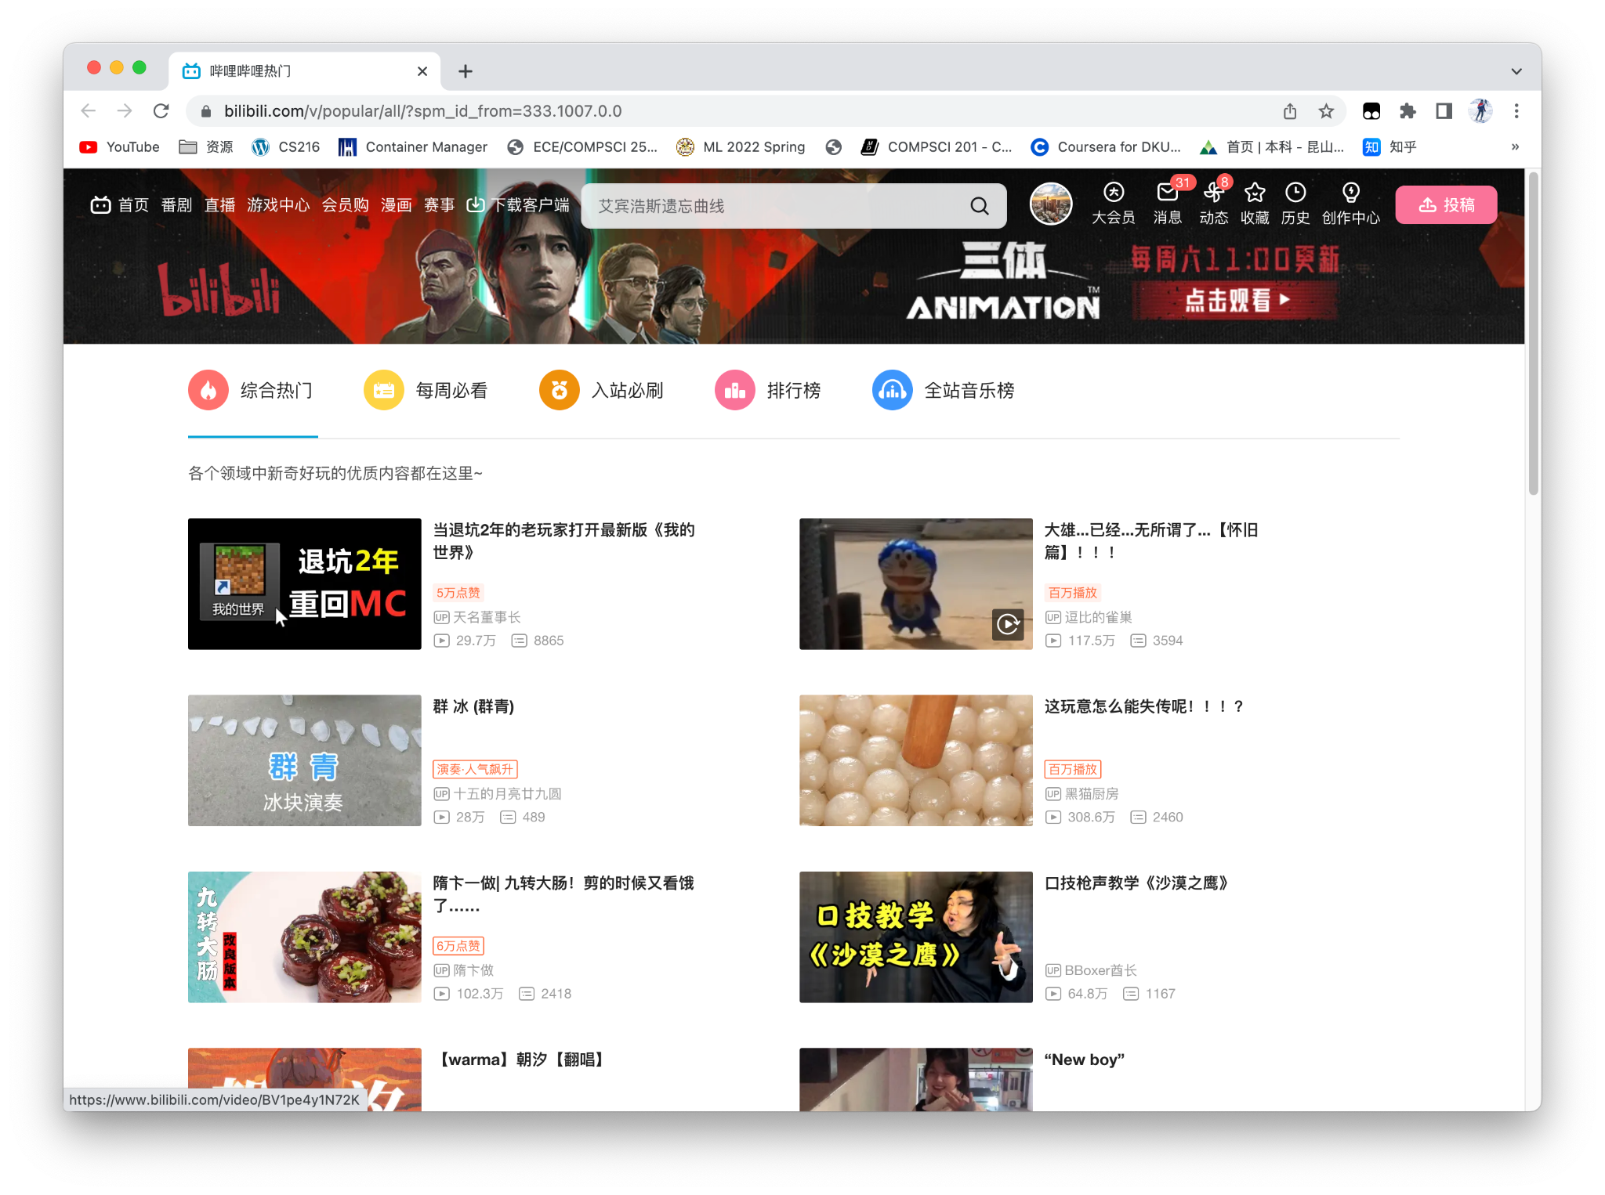
Methodology - Data Collection
Popular
(500 videos)
Weekly Popular
(6559 videos)

Slide 5
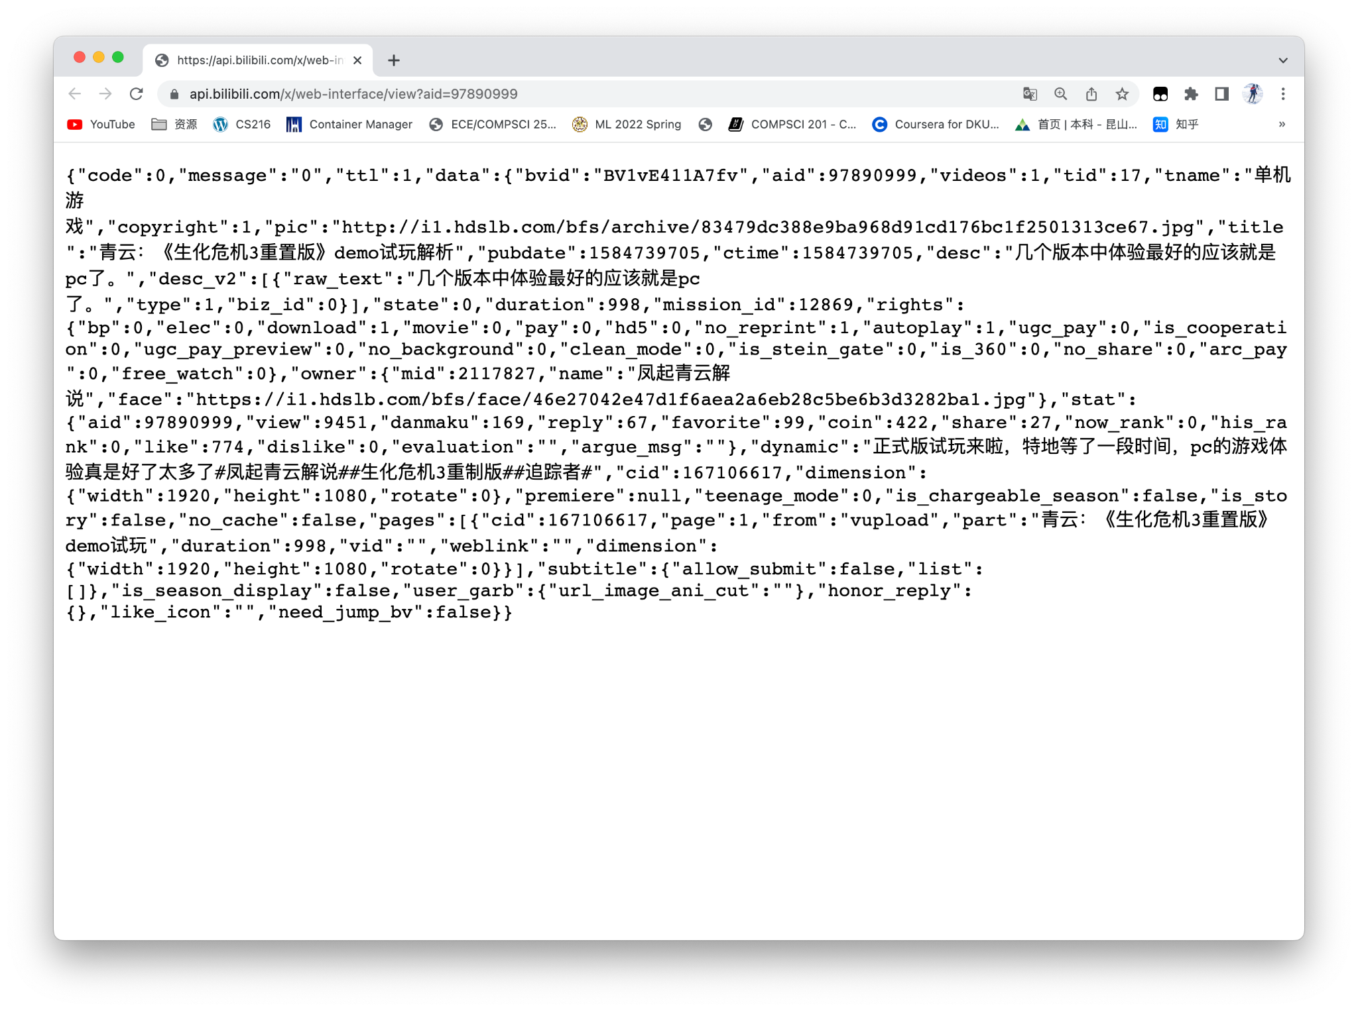
Methodology - Data Collection
Most Recent
(500 videos)
Searching back from avid = 97890999
Column collected:
tid(type id), tname(type name), title, desc(description), duration, stat(interactive information of the video), dynamic, rcmd_reason, bvid(unique id of the video), owner, pub_location

Slide 6
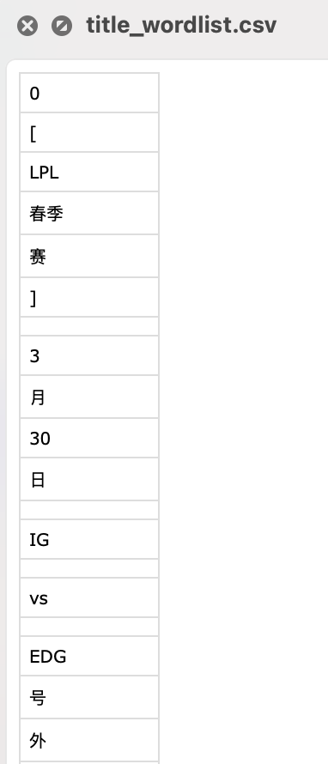
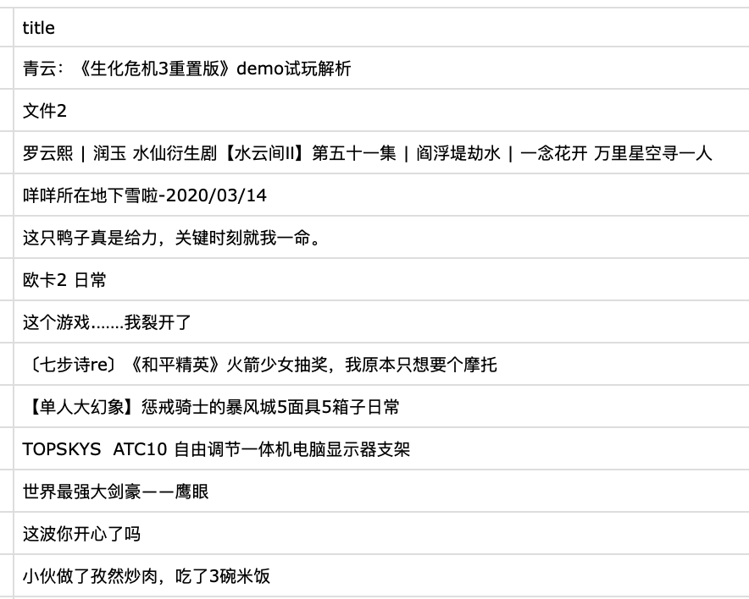
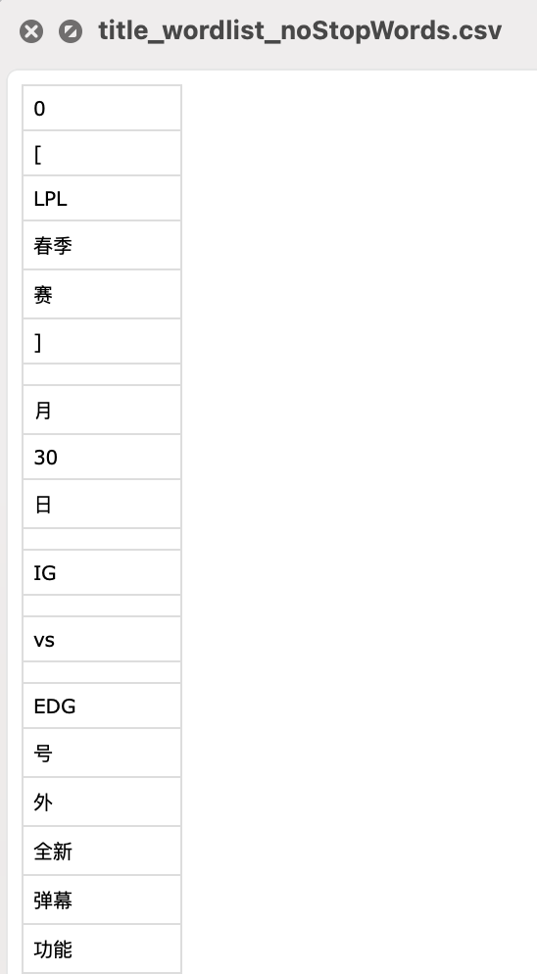
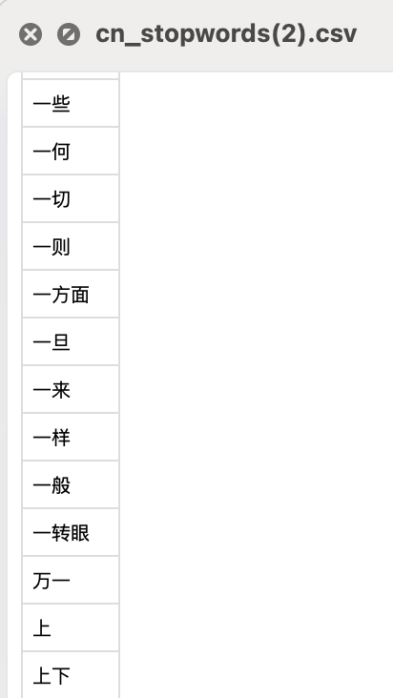
Methodology - Data Cleaning and Processing
Separating Chinese Words
Original Wordlist
Wordlist Without Stopwords
Column of text
Adapted Stopwords List

Slide 7
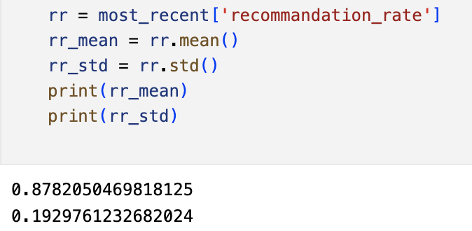
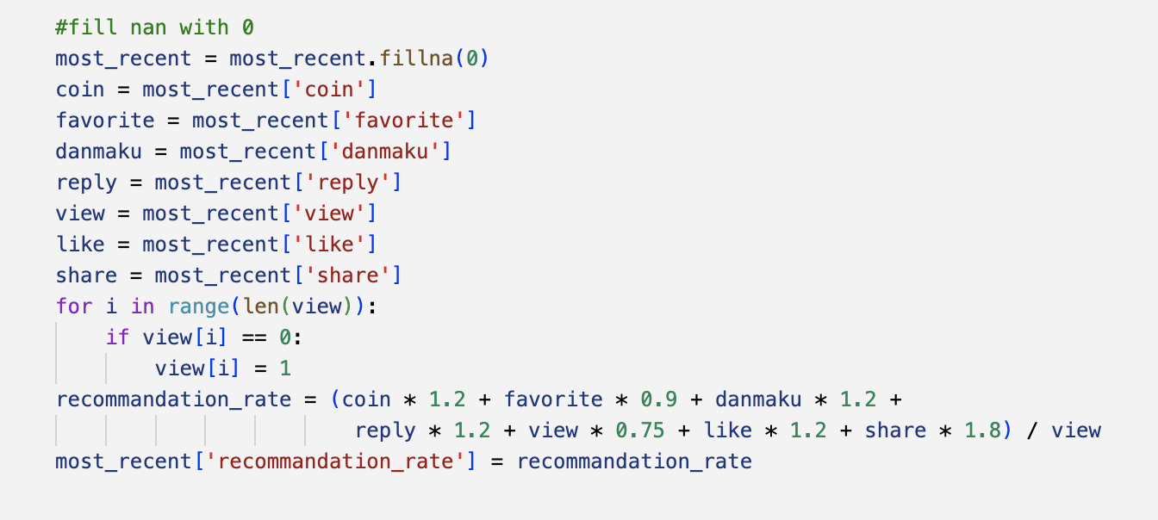
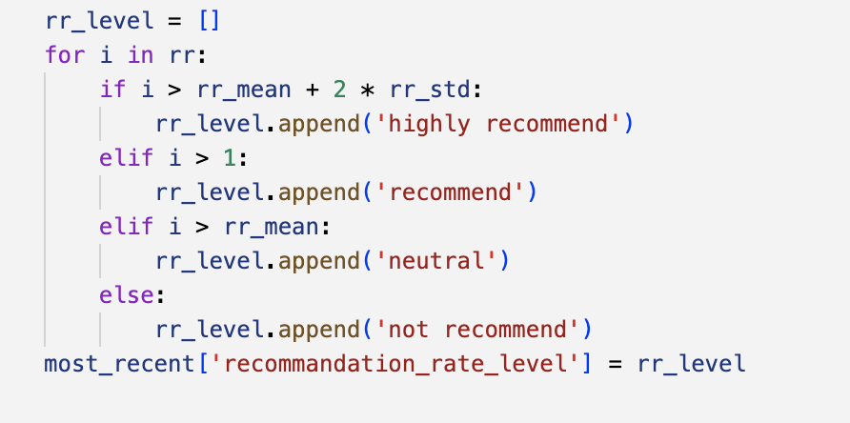
Methodology - Data Cleaning and Processing
Recommendation Level
Mean and Variance
Recommendation Rate
Recommendation Level

Slide 8
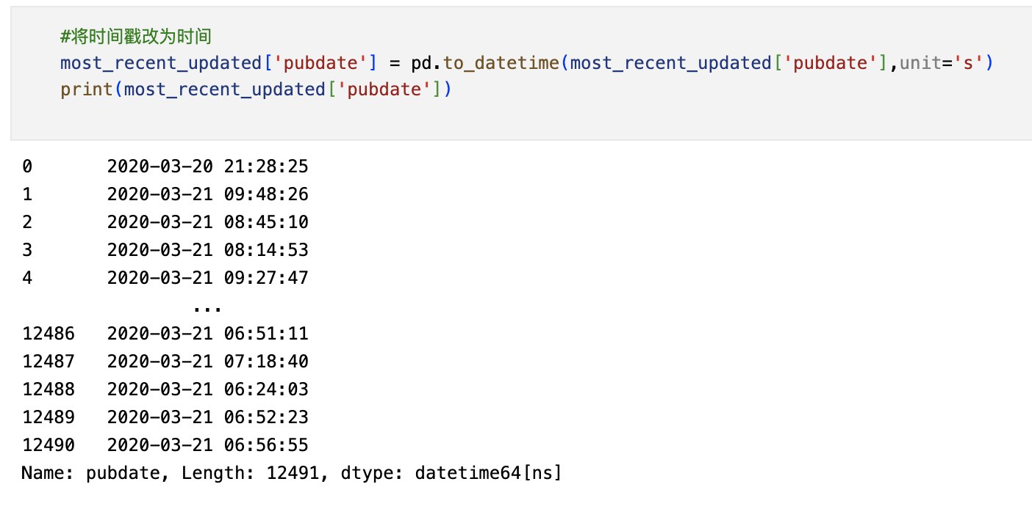
Methodology - Data Cleaning and Processing
Timestamps to Traditional Form

Slide 9
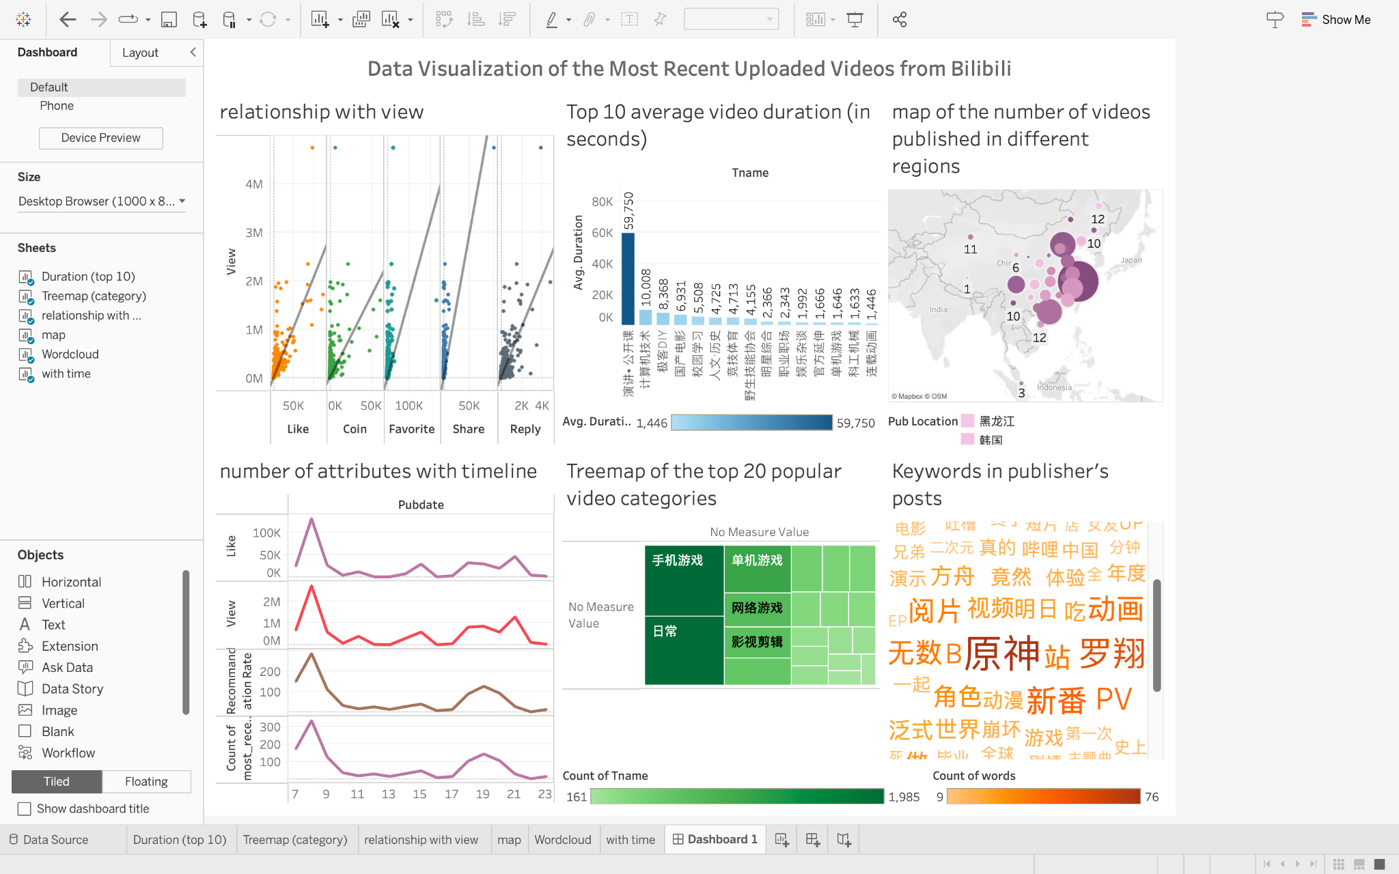
Methodology - Visualization
We visualized the data using Tableau with different attributes, idioms, marks, and channels.

Slide 10
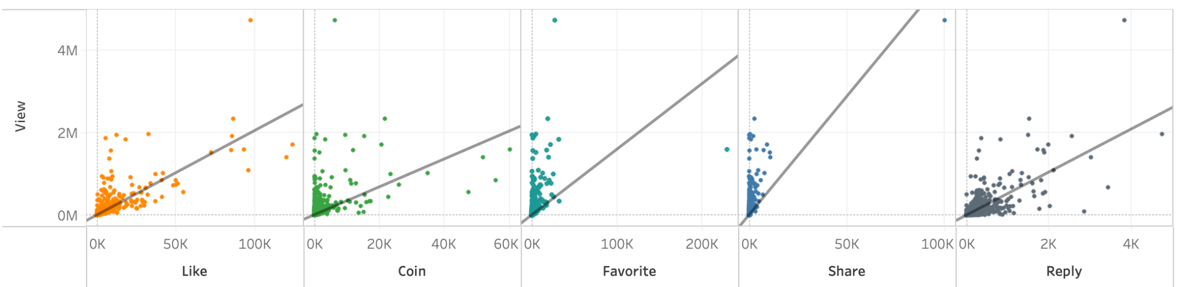
Results
The dot plots of relationship between the audience feedback and number of views:

Slide 11
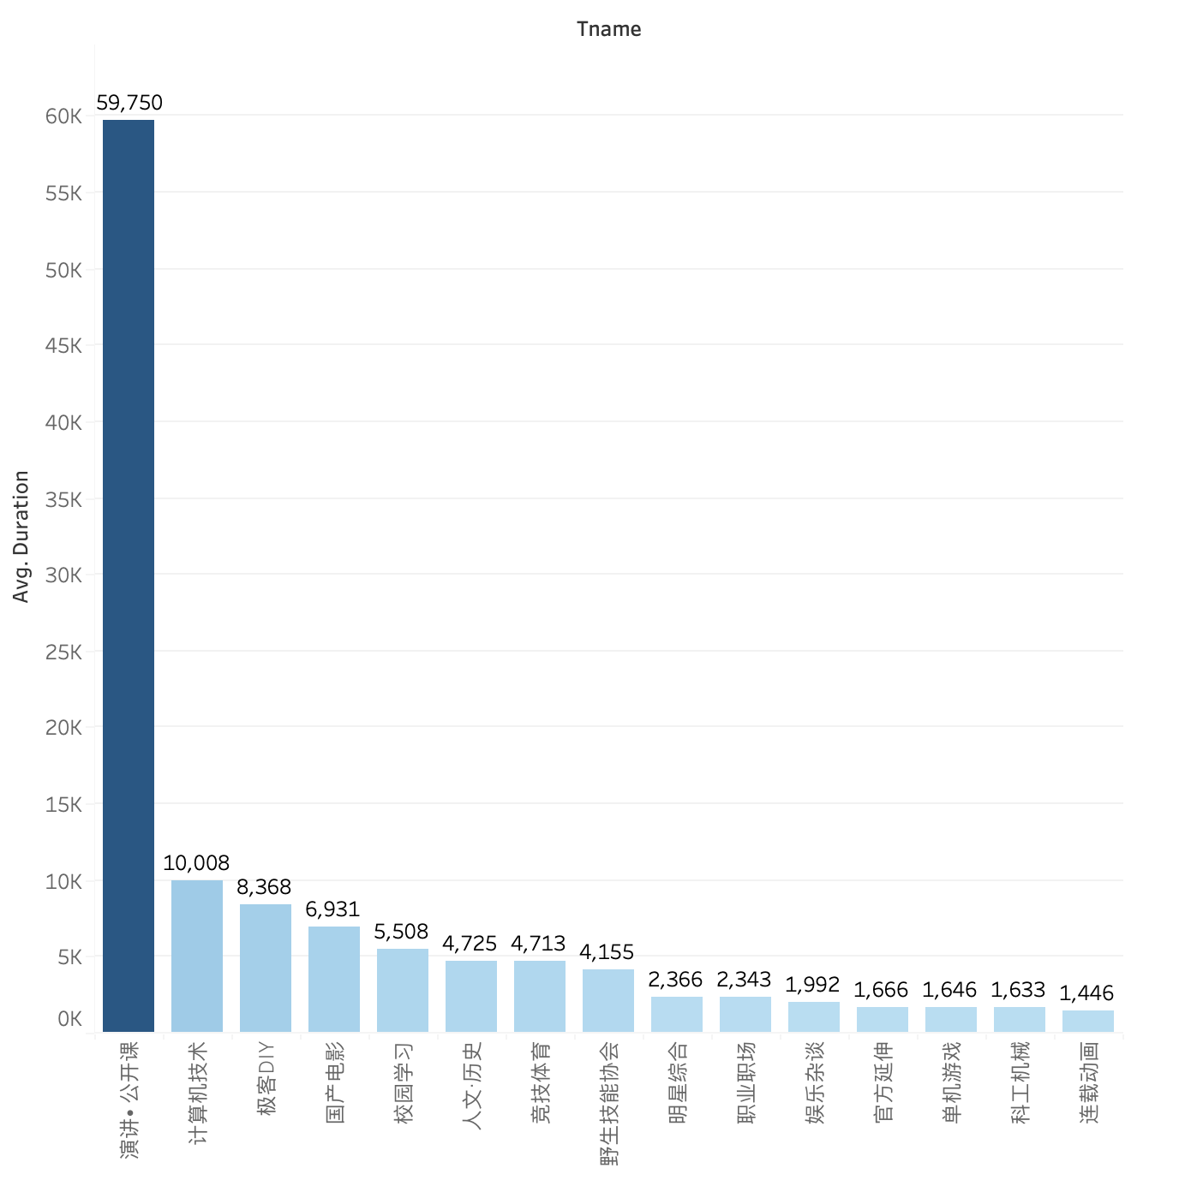
Results
(2) The bar plot of average duration of the videos from different categories:

Slide 12
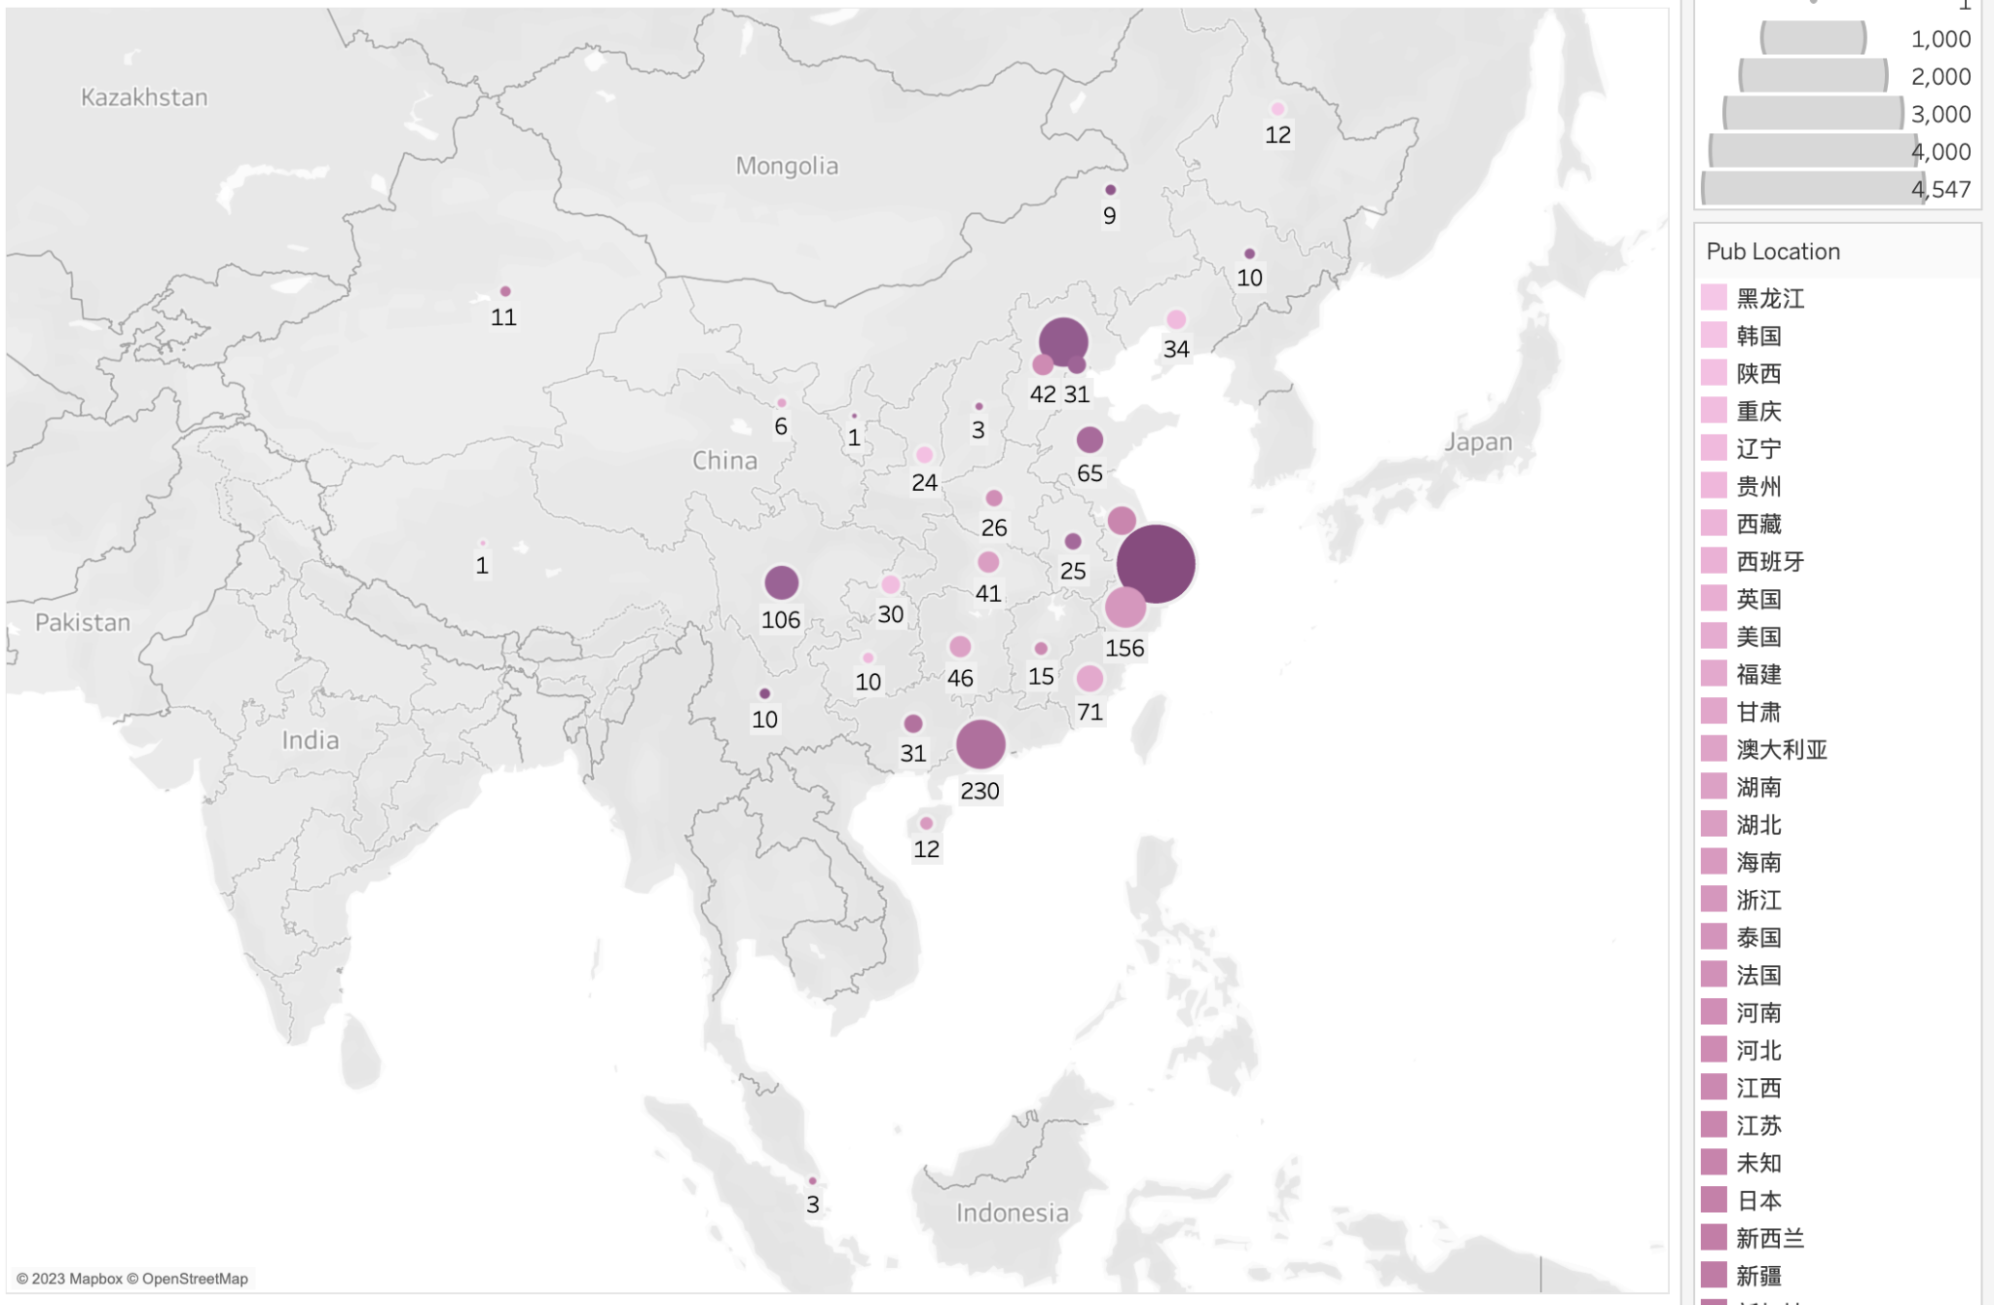
Results
(3) The symbol map of the number of videos published in different regions:

Slide 13
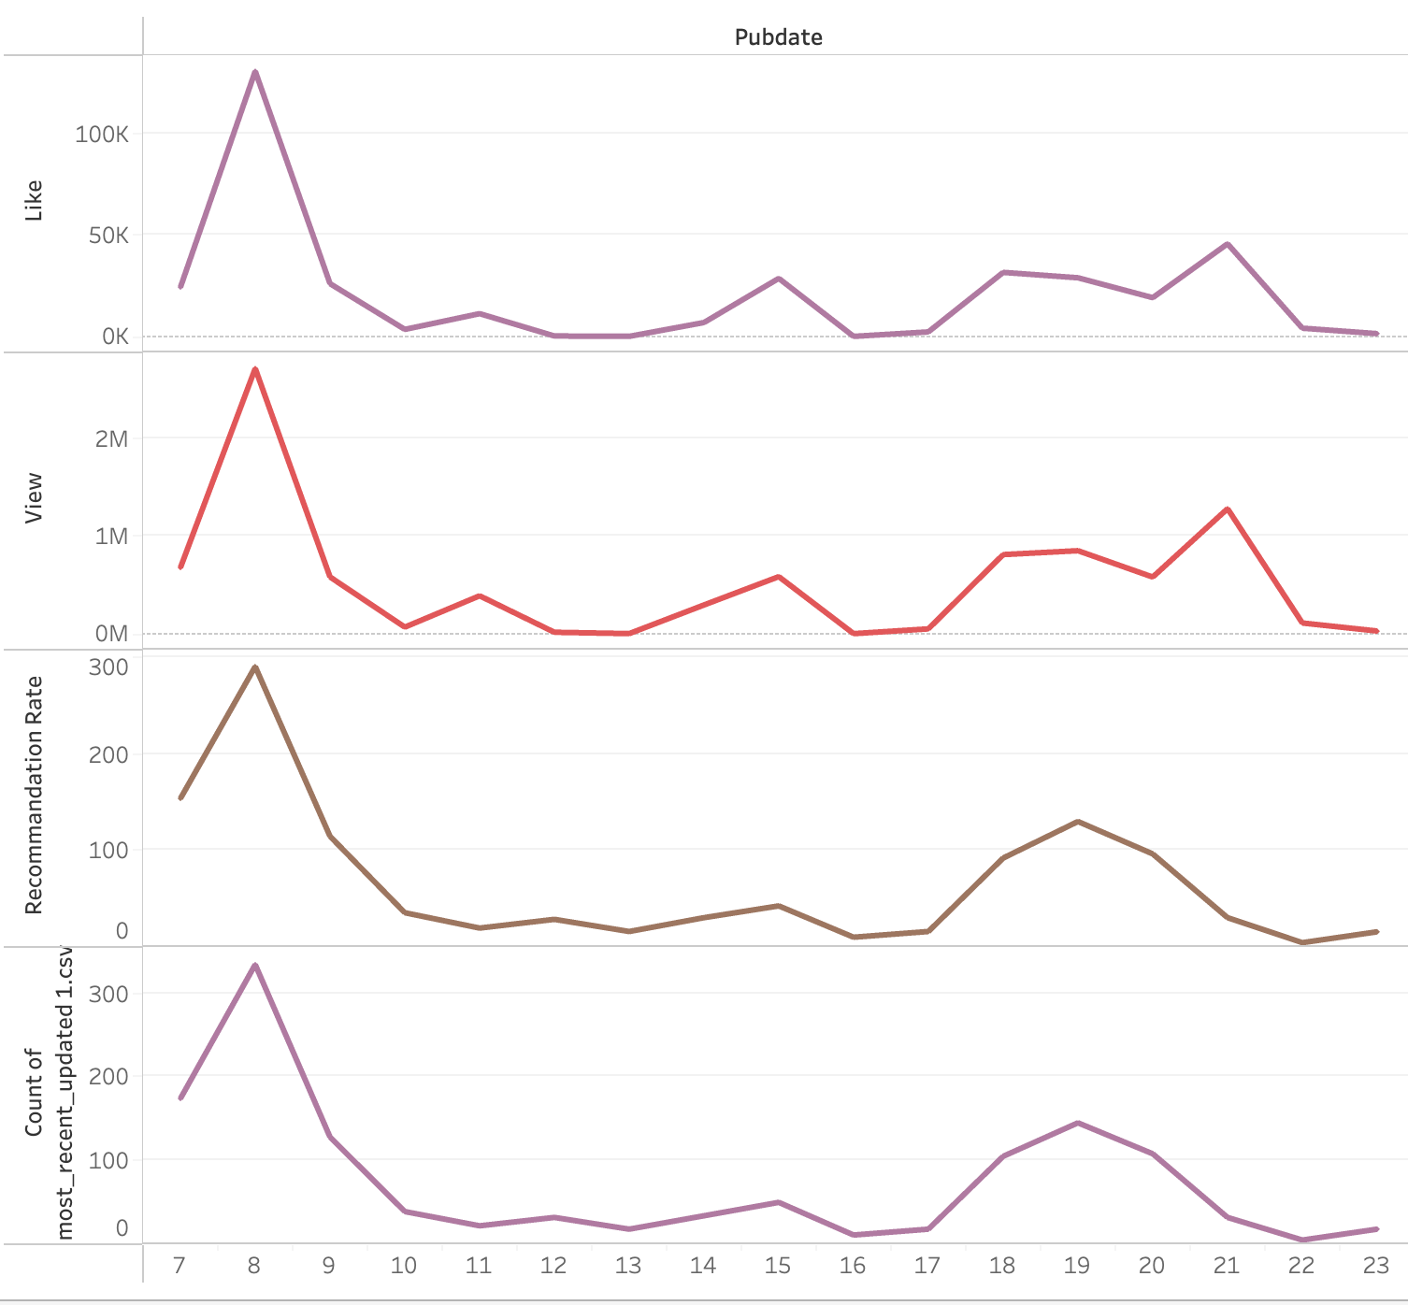
Results
(4) The line chart of the characteristics of the videos published in different hours

Slide 14
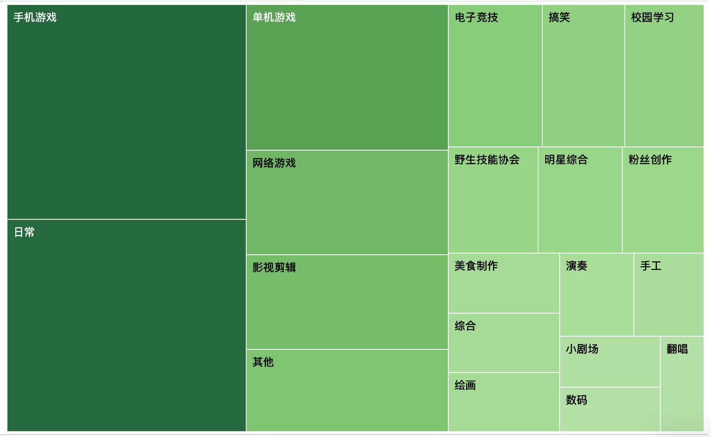
Results
(5) The treemap of the top 20 popular video categories:

Slide 15

Results
(6) The word cloud of the most frequently used keywords in the publisher’s posts:

Slide 16
Discussion
Advantages
Limitations
Our visualizations perfectly show the data we collected and answer our research questions.
Our data is not distributed across different days.
Jieba package is not strong enough to separate some of the commonly used words by bilibili users.

Slide 17
References
“Corporate Information.” n.d. Accessed February 5, 2023. https://ir.bilibili.com/en/corporate-information/.
Song, Shilin. n.d. “What Is Bilibili? A Look into One of China’s Largest Online Video Platforms - WalktheChat.” Accessed February 5, 2023. https://walkthechat.com/what-is-bilibili-a-look-into-one-of-chinas-largest-online-video-platforms/.
“大揭秘！B站‘热门’视频是怎么选出来的？.” n.d. 知乎专栏. Accessed February 5, 2023. https://zhuanlan.zhihu.com/p/490919116.

Slide 18
Thanks!
Q&A

